Slide 1






Presentation
JSON with Java
Presenter：Team17
Time：Nov.2020
Team Members：
1853802 Jintao Xie
1851202 Hong Lei
1853806 Jiaqi Wu
1851906 Yusen Li

Slide 2
1
PART 01 Overview
A brief Overview of the Json with Java Technology
2
PART 02 GSON for Java
CONTENTS
An Open-source Library Developed By Google。
3
PART 03 Jackson for Java
An Open-source JSON Library Developed By FasterXML
4
PART 04 Comparison

Slide 3

PART ONE
Overview of Json With Java

Slide 4
Ⅰ Definition
Ⅱ Reasons
Ⅲ Implement
Learn It Now

Slide 5
Ⅰ. Definition
json to java
java to json
Learn It Now

Slide 6
Ⅱ. Reasons
Two format Characters
Serialized
and Deserialized
Easy to Delivery
Easy to Code

Slide 7
Gson
Ⅲ. Implement
Jackson
Other Libraries
(FastJSON etc.)

Slide 8
PART TWO
GSON for Java
——An Open-source Library Developed By Google

Slide 9
Overview
· Gson is a Java library that can be used to convert Java Objects into their JSON representation.
· It can also be used to convert a JSON string to an equivalent Java object.
· Gson can work with arbitrary Java objects including pre-existing objects that you do not have source code of.
· Considering other open-source projects, most of them:
①require that users place Java annotations in your classes
②also do not fully support the use of Java Generics.
· Gson considers both of these as very important design goals.
Use It Now

Slide 10
Why we should be using the library~
5 Advantages:
· Standardized
Gson is a standardized library that is managed by Google.
· Efficient
Gson is a reliable, fast, and efficient extension to the Java standard library.
· Optimized
The library is highly optimized.
· Support Generics
It provides extensive support for generics.
· Supports complex inner classes
Gson supports complex objects with deep inheritance hierarchies.

Slide 11

Features of Gson
Easy to use -
Gson API provides a high-level facade to simplify commonly used use-cases.
01
02
No need to create mapping –
Gson API provides default mapping for most of the objects to be serialized.
03
Performance –
Gson is quite fast and is of low memory footprint. It is suitable for large object graphs or systems.
Clean JSON –
Gson creates a clean and compact JSON result which is easy to read.
04
05
No Dependency –
Gson library does not require any other library apart from JDK.
Open Source –
Gson library is open source; it is freely available.
06

Slide 12
Two significant methods of GSON

toJson()
Used to convert Java objects to JSON, mainly in the following forms:
（1）String toJson(JsonElement jsonElement);
（2）String toJson(Object src);
（3）String toJson(Object src, Type typeOfSrc);
Besides, method (1) is used to convert JsonElement object which can be JsonObject, JsonArray, etc..) into Json data;
method (2) serializes the specified objects into the corresponding JSON data;
method (3) is used to serialize the specified Object which can include generic types into the corresponding JSON data.
→
fromJson()
Used to convert JSON to Java objects, mainly in the following forms:
（1）<T> T fromJson(JsonElement json, Class<T> classOfT);
（2）<T> T fromJson(JsonElement json, Type typeOfT);
（3）<T> T fromJson(JsonReader reader, Type typeOfT);
（4）<T> T fromJson(Reader reader, Class<T> classOfT);
（5）<T> T fromJson(Reader reader, Type typeOfT);
（6）<T> T fromJson(String json, Class<T> classOfT);
（7）<T> T fromJson(String json, Type typeOfT);
All of them are used to parse the different forms of JSON data into Java objects








Slide 13
Experimentation —— Using Gson
IDE: eclipse
Create a maven project
Import Gson
Primitives Examples
Object Examples
Array Examples
Collections Examples
Serializing and Deserializing
Others

Slide 14

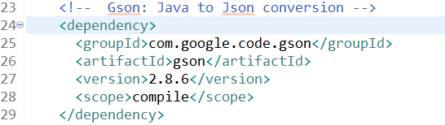
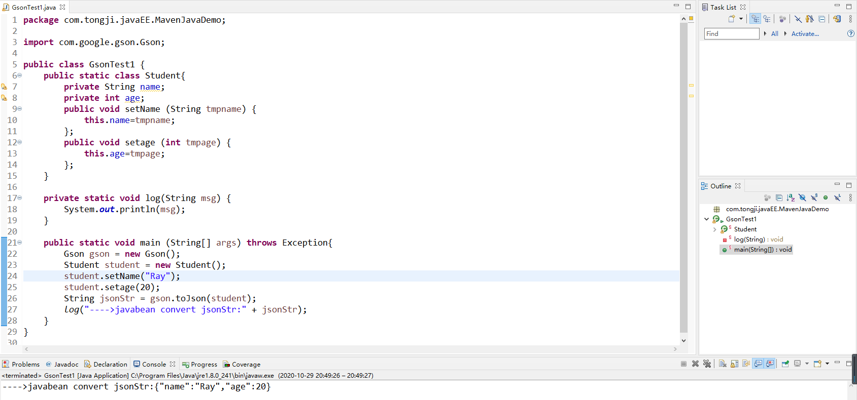
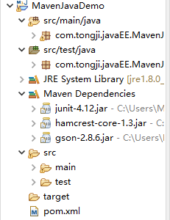
Preparation
Create a maven project
3rd Step
2nd Step
1st Step
Import Gson
Experimentations

Slide 15
PART THREE
Jackson for Java
—— An Open-source JSON Library Developed By FasterXML

Slide 16
Features
High performance and stability
Low memory usage, excellent performance in convertion between large or small JSON strings and POJOs
1
High Popularity
Default choice for many popular frameworks, complete and standard English documents
2
Easy to Use
Provide flexible APIs, which are extensible
Encapsulate some common modules like new time and date type in Java8
3
Various mapping relations
Jackson covers mapping relations between most string types like JSON or XML and Java objects
4
5
Spring Frameworks support
Jackson is the default JSON/XML parser in Spring Frameworks

Slide 17
Three Core Modules
com.fasterxml.jackson.core
Define APIs for underlying data processing stream, like JsonParser.class and JsonGenerator.class
com.fasterxml.jackson.annotations
Contains standard Jackson annotations
com.fasterxml.jackson.databind
Implement data binding and object serialization on “com.fasterxml.jackson.core”module, this module depends on th above two modules, it also provides high level APIs that we can directly use

Slide 18
Three key operations
JSON<->OBJECT
(1)ObjectMapper.readValue(JsonElement,Object.class); // JSON->OBJECT
(2)ObjectMapper.writeValueAsString(Object); // OBJECT->JSON
JSON<->NODE
(1)ObjectMapper.readTree(JsonElement); // JSON->NODE
(2)ObjectMapper.writeValueAsString(Node); // NODE->JSON
OBJECT<->NODE
(1)ObjectMapper.treeToValue(Node,Object.class); // NODE->OBJECT
(2)ObjectMapper.valueToTree(Object); // OBJECT->NODE
A main interface in Jackson — — ObjectMapper

Slide 19
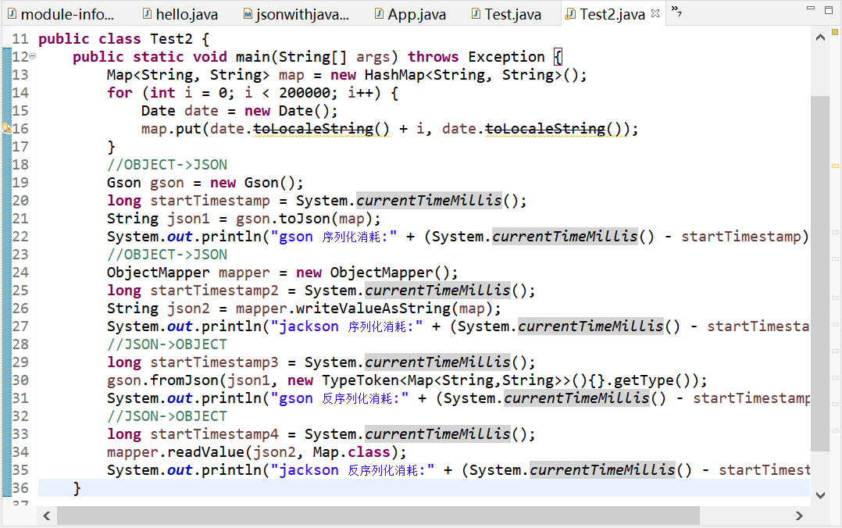
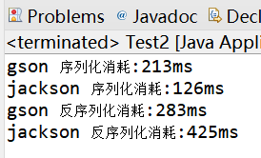
TEST

Slide 20
PART FOUR
Comparison between Methods

Slide 21
Performance
Serialized
(Obj=>Json)
Deserialized
(Json=>Obj)
Library | Size | Times | Max T | Min T | Avg T
Jackson | 100000 | 10 | 1980 (ms) | 841 (ms) | 880 (ms)
Gson | 100000 | 10 | 2383 (ms) | 1469 (ms) | 1520 (ms)
Library | Size | Times | Max T | Min T | Avg T
Jackson | 100000 | 10 | 7957 (ms) | 6632 (ms) | 6815 (ms)
Gson | 100000 | 10 | 8235 (ms) | 7006 (ms) | 7364 (ms)

Slide 22
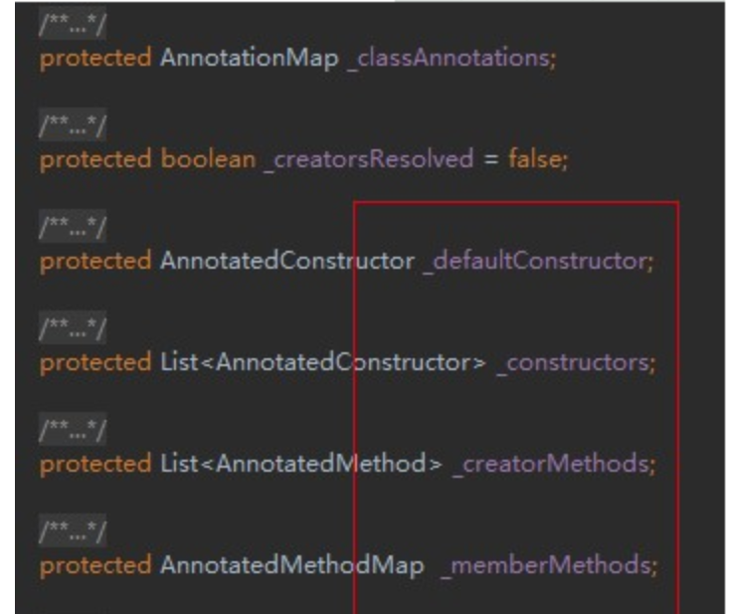
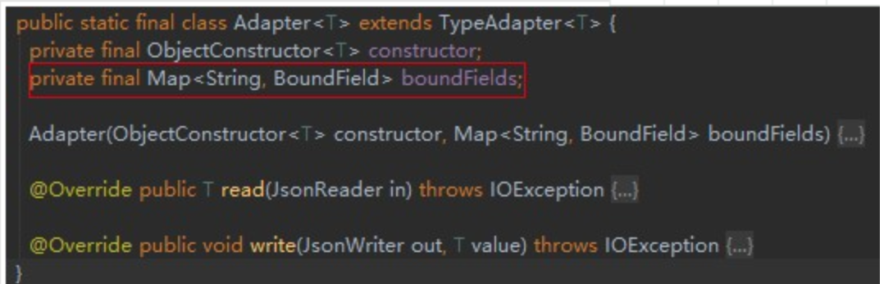
Character
Jackson
Gson
Jackson is Powerful： support stream、databind、
path
Package:1.2M ,
Several Hundred KB
Memory Needed,
Effective Memory
Management
Package:143 K ,
Less than 100 KB
Memory Needed,
Not Such good
Memory
Management
Direct and Easy
Reflection Cache
Complex Reflection Cache

Slide 23

Thanks for Listening
Presenter：Team17
Time：Nov.2020

